Slide 1

Codergirl – Frontend
Unit 2 - Class 12
Jan 20, 2021
Notes:
1

Slide 2
Agenda
Section 18 – making http requests.
Studio – Section 19 course project - http.
Notes:
2

Slide 3
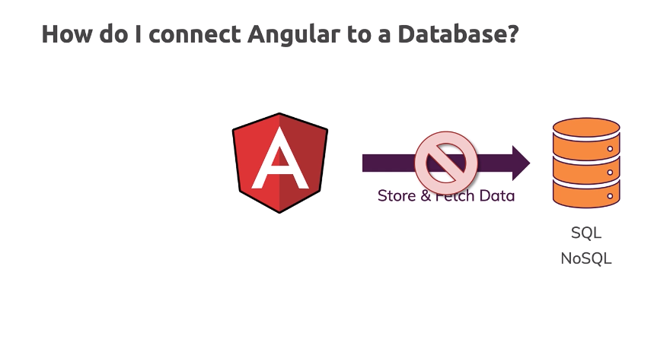
Http and Backend Integration
Save and fetch data
Angular does not connect directly to DB from frontend
Notes:
3

Slide 4
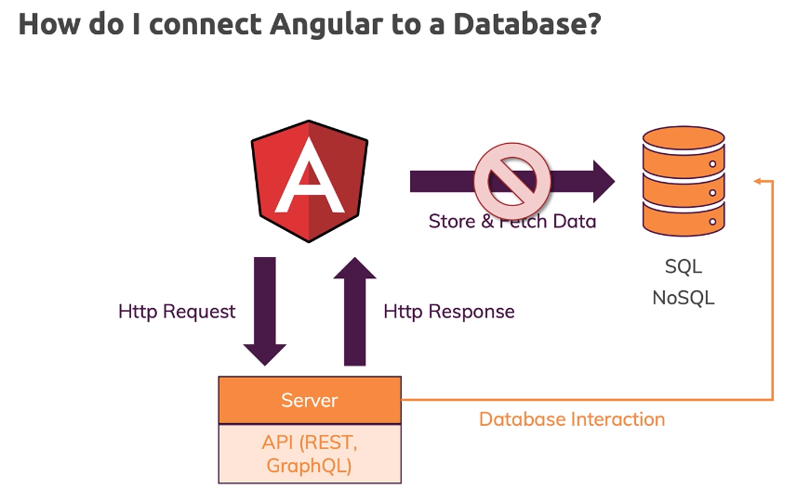
Http and Backend Integration
Save and fetch data
Angular does not connect directly to DB from frontend
We will use a dummy backend
Notes:
4

Slide 5
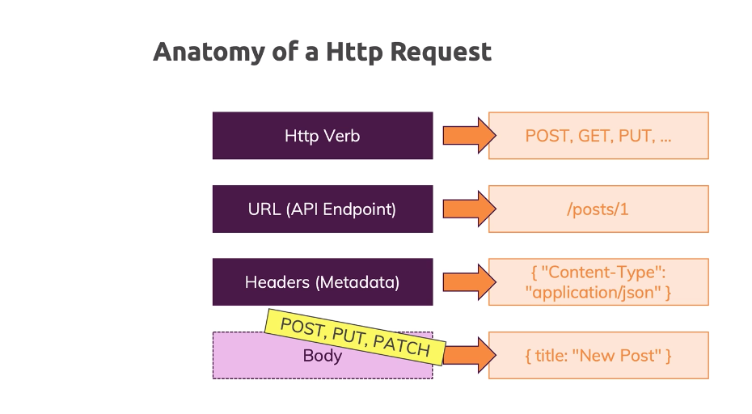
Anatomy of HTTP request
Endpoints and operations depend on API
Need to append headers
Body attached to some request types.
Notes:
5

Slide 6
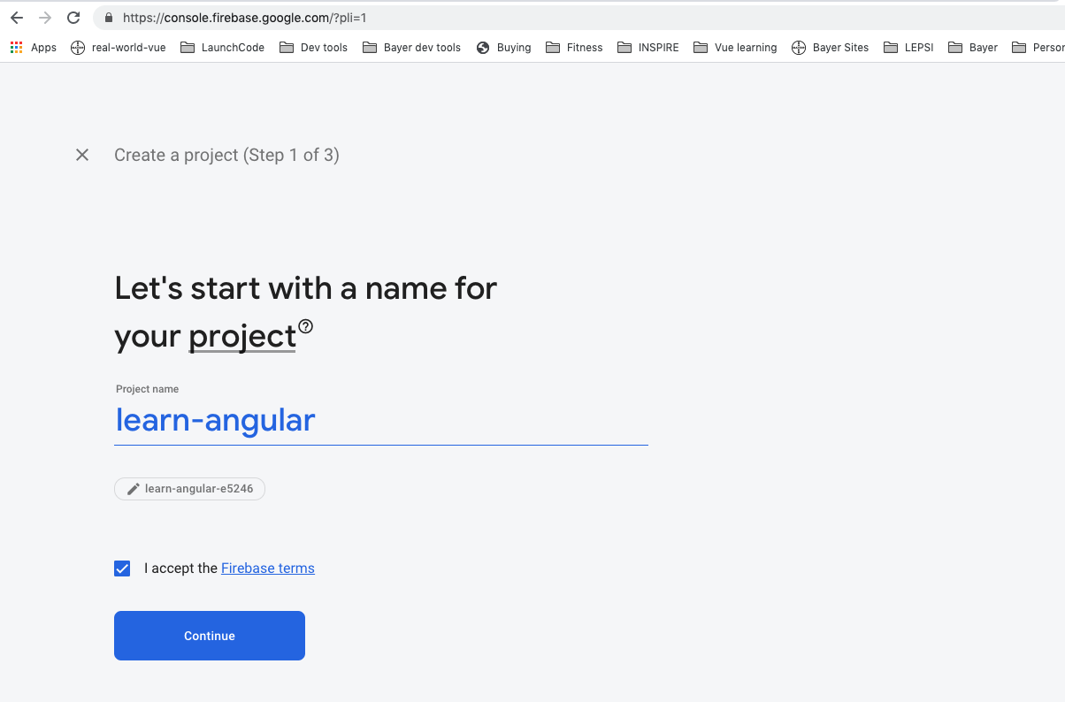
Firebase backend solution
Free and needs a google account
https://console.firebase.google.com/?pli=1
Notes:
6

Slide 7
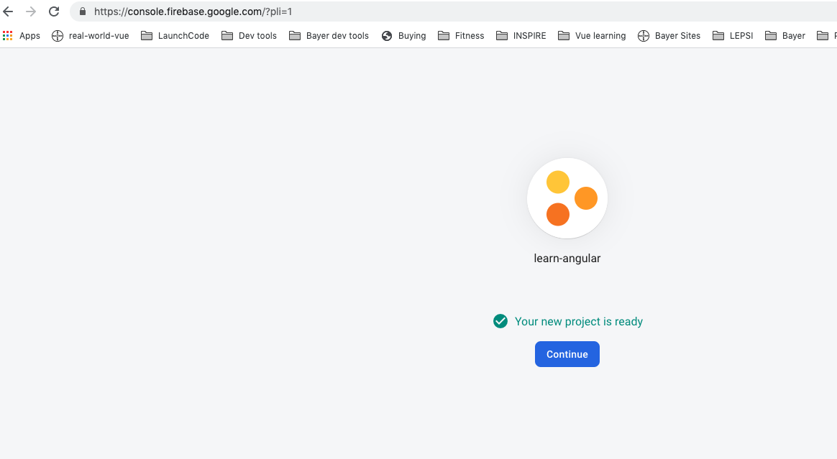
Firebase backend solution
Free and needs a google account
https://console.firebase.google.com/?pli=1
Notes:
7

Slide 8
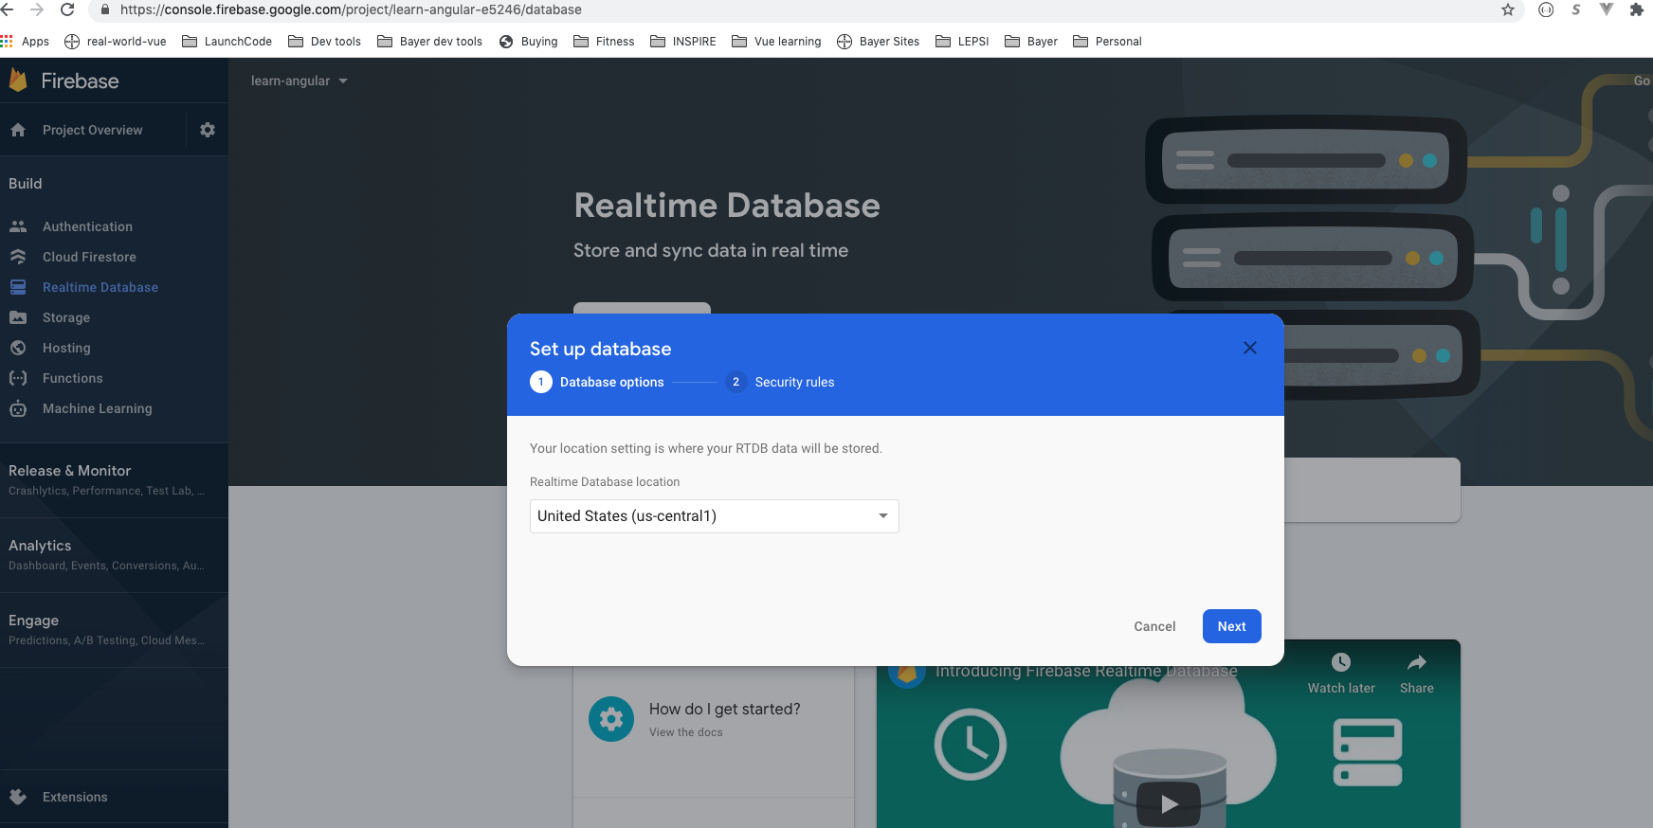
Firebase backend solution
Free and needs a google account
https://console.firebase.google.com/?pli=1
Notes:
8

Slide 9
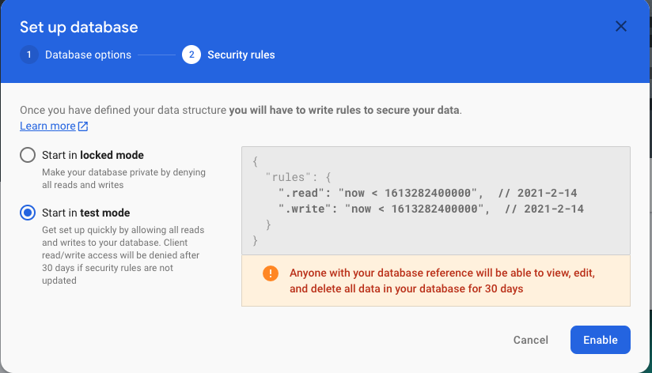
Firebase backend solution
Free and needs a google account
https://console.firebase.google.com/?pli=1
Notes:
9

Slide 10
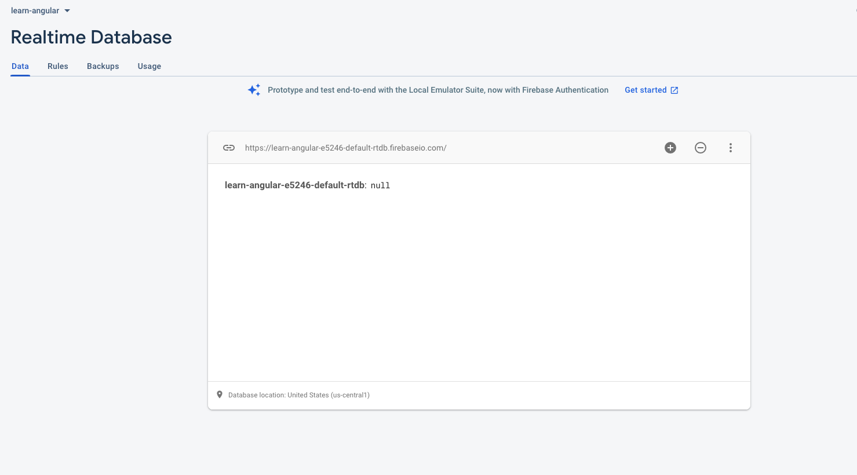
Firebase backend solution
Free and needs a google account
https://console.firebase.google.com/?pli=1
Notes:
10

Slide 11
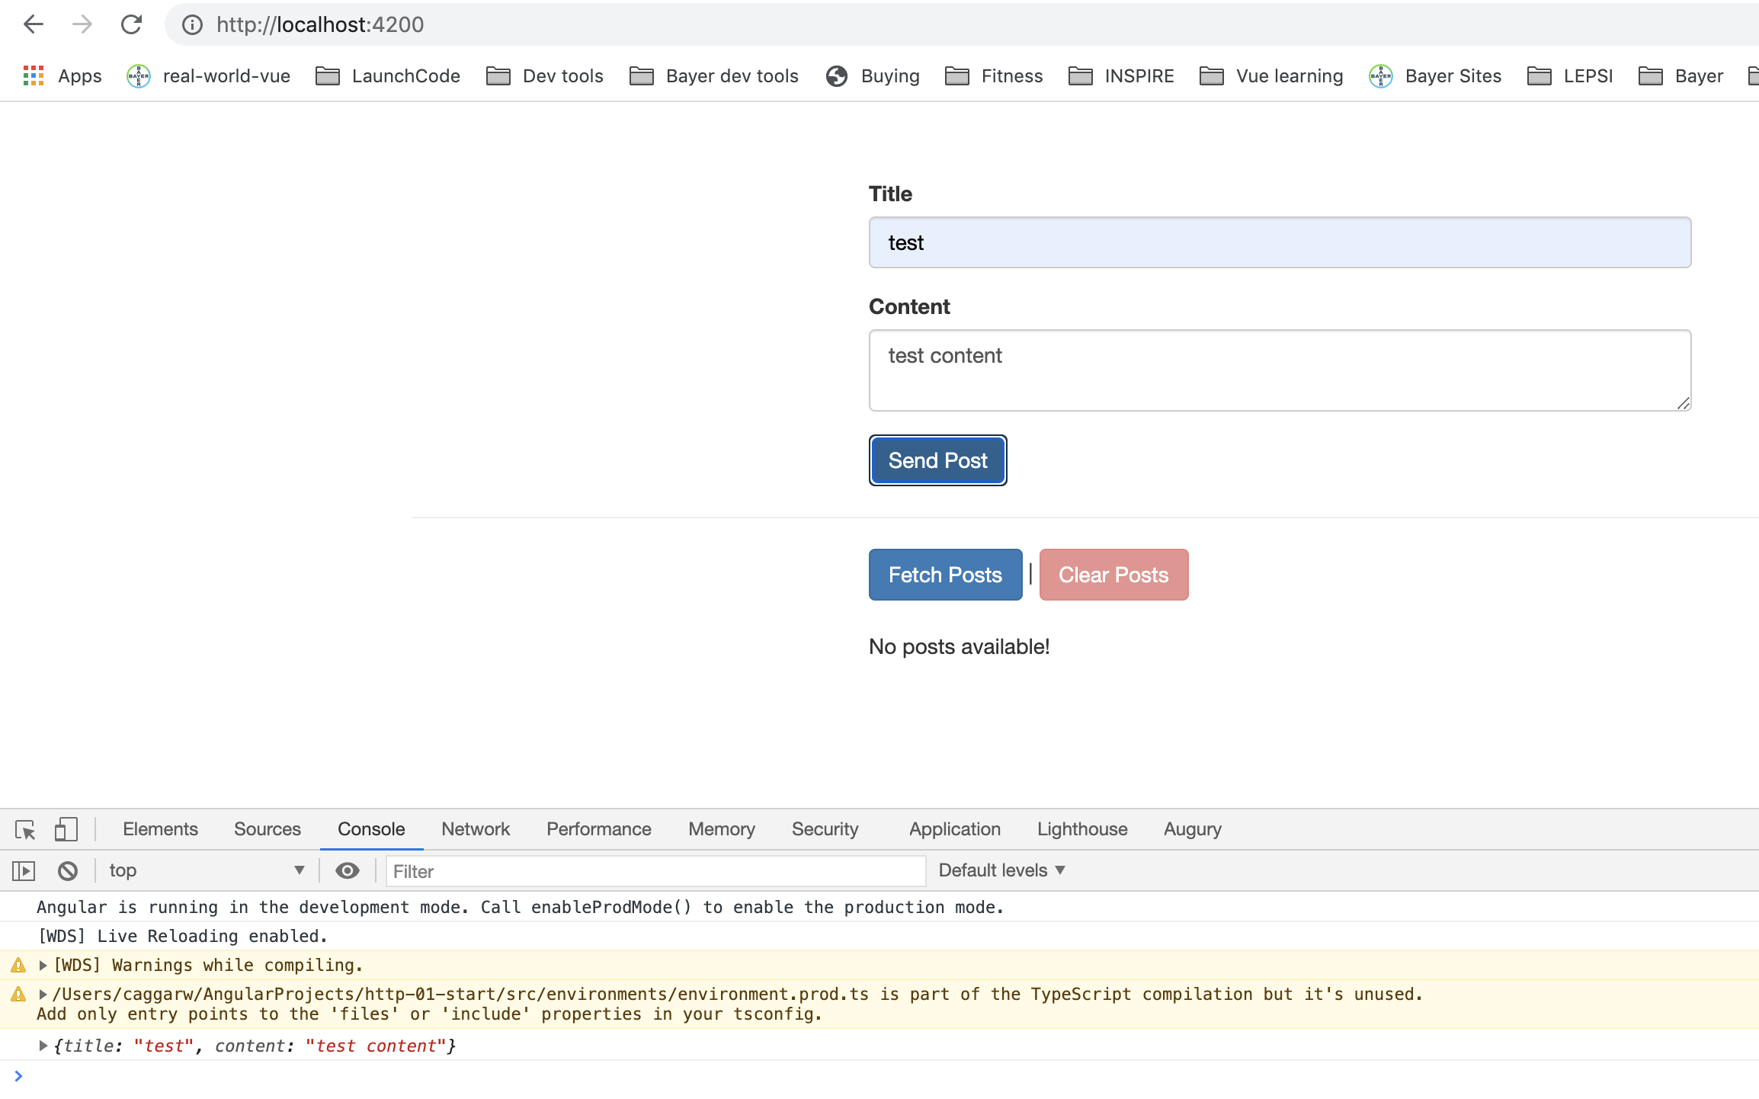
Firebase backend solution
Free and needs a google account
https://console.firebase.google.com/?pli=1
Notes:
11

Slide 12

Firebase backend solution
IMPORT
Notes:
12

Slide 13
HTTP
Notes:
13

Slide 14
subscribe to post
Notes:
14

Slide 15
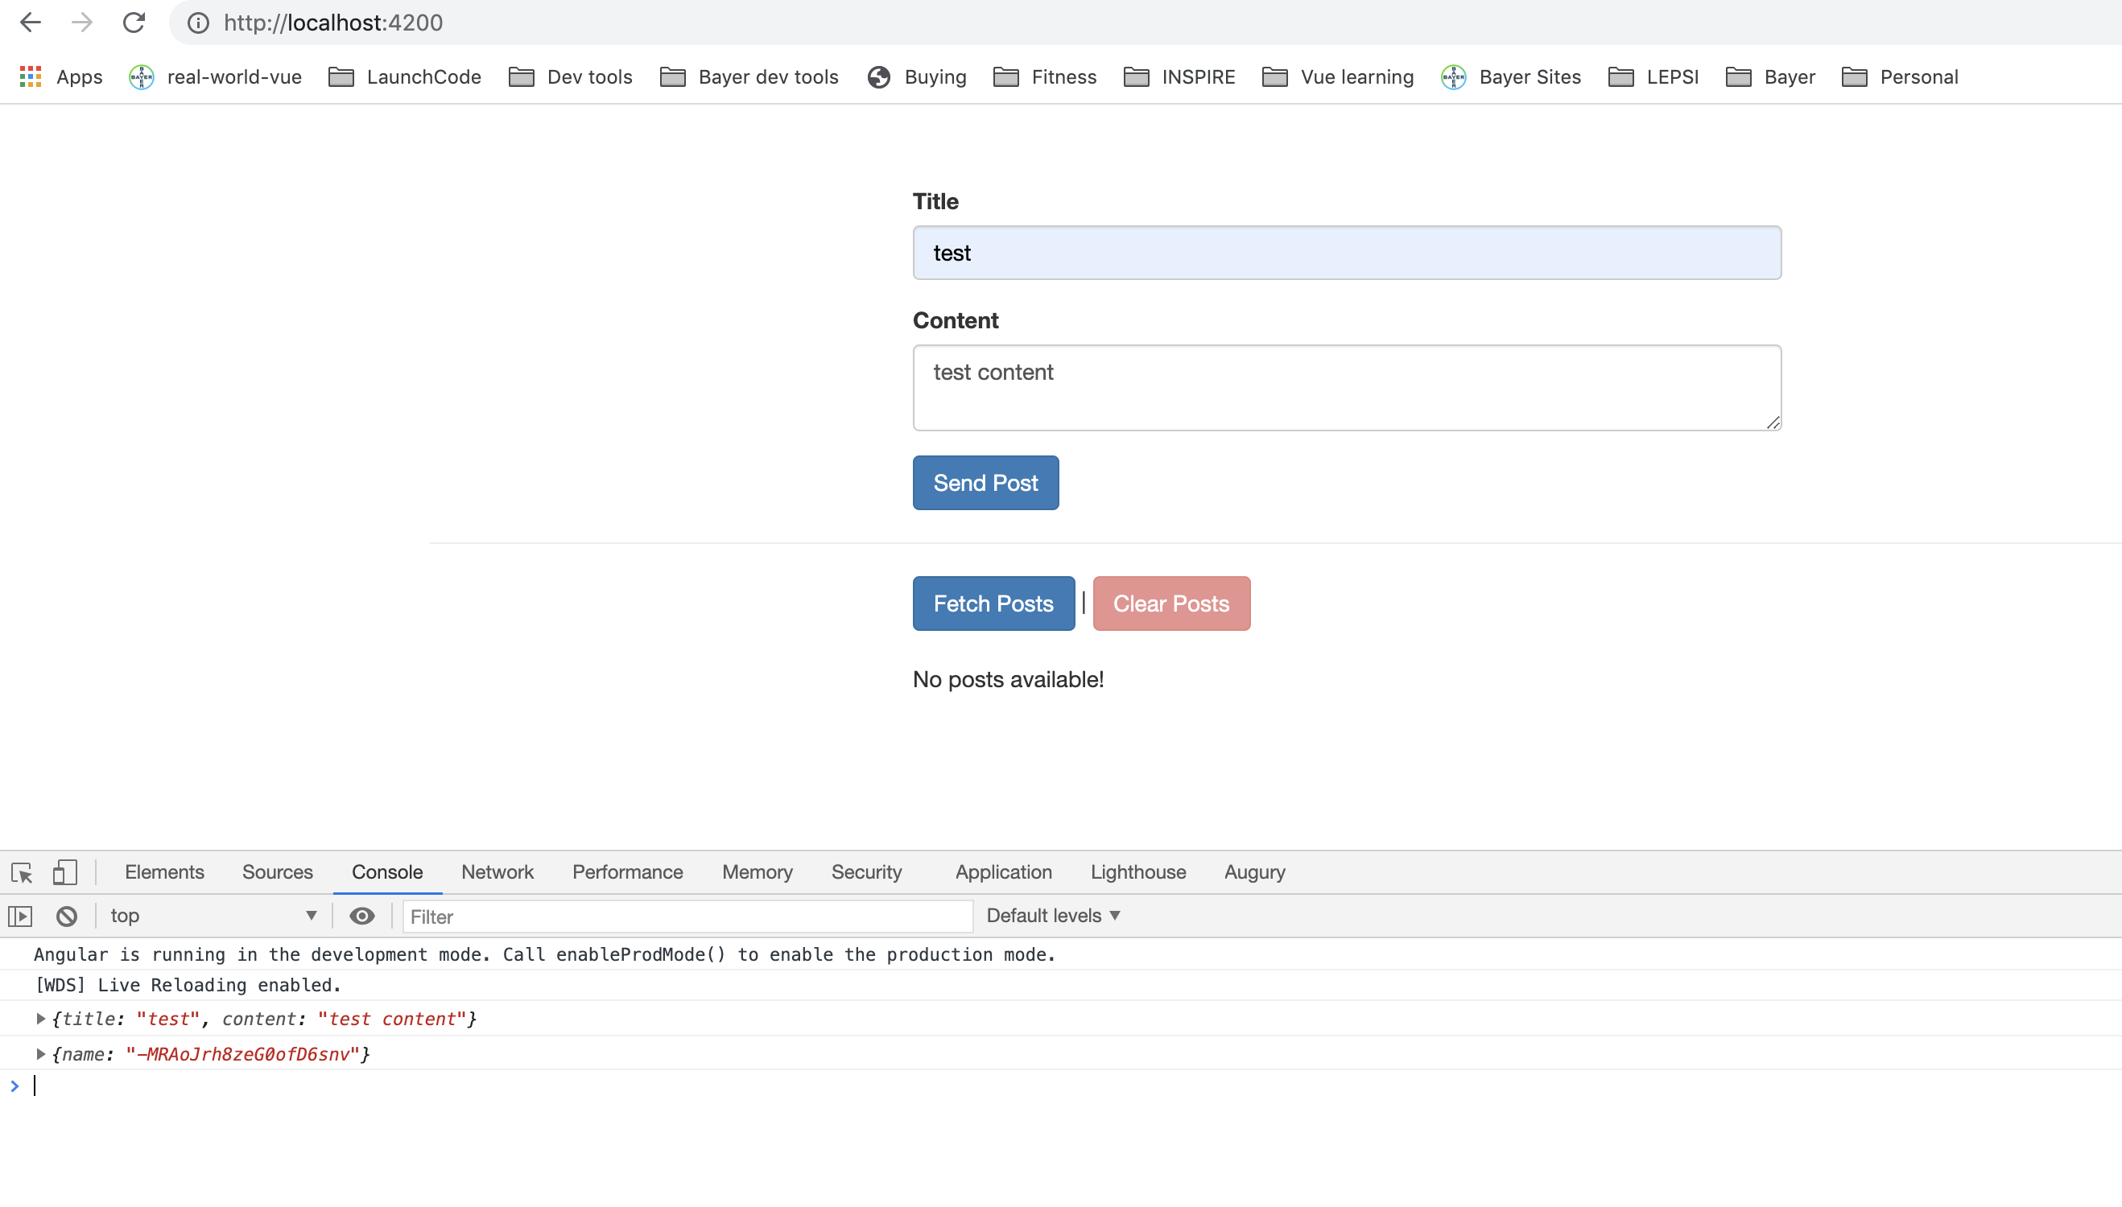
subscribe to post
Notes:
15

Slide 16
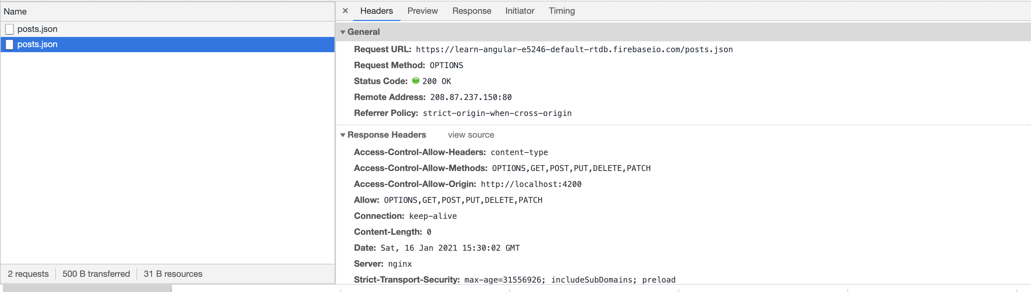
subscribe to post
Notes:
16

Slide 17
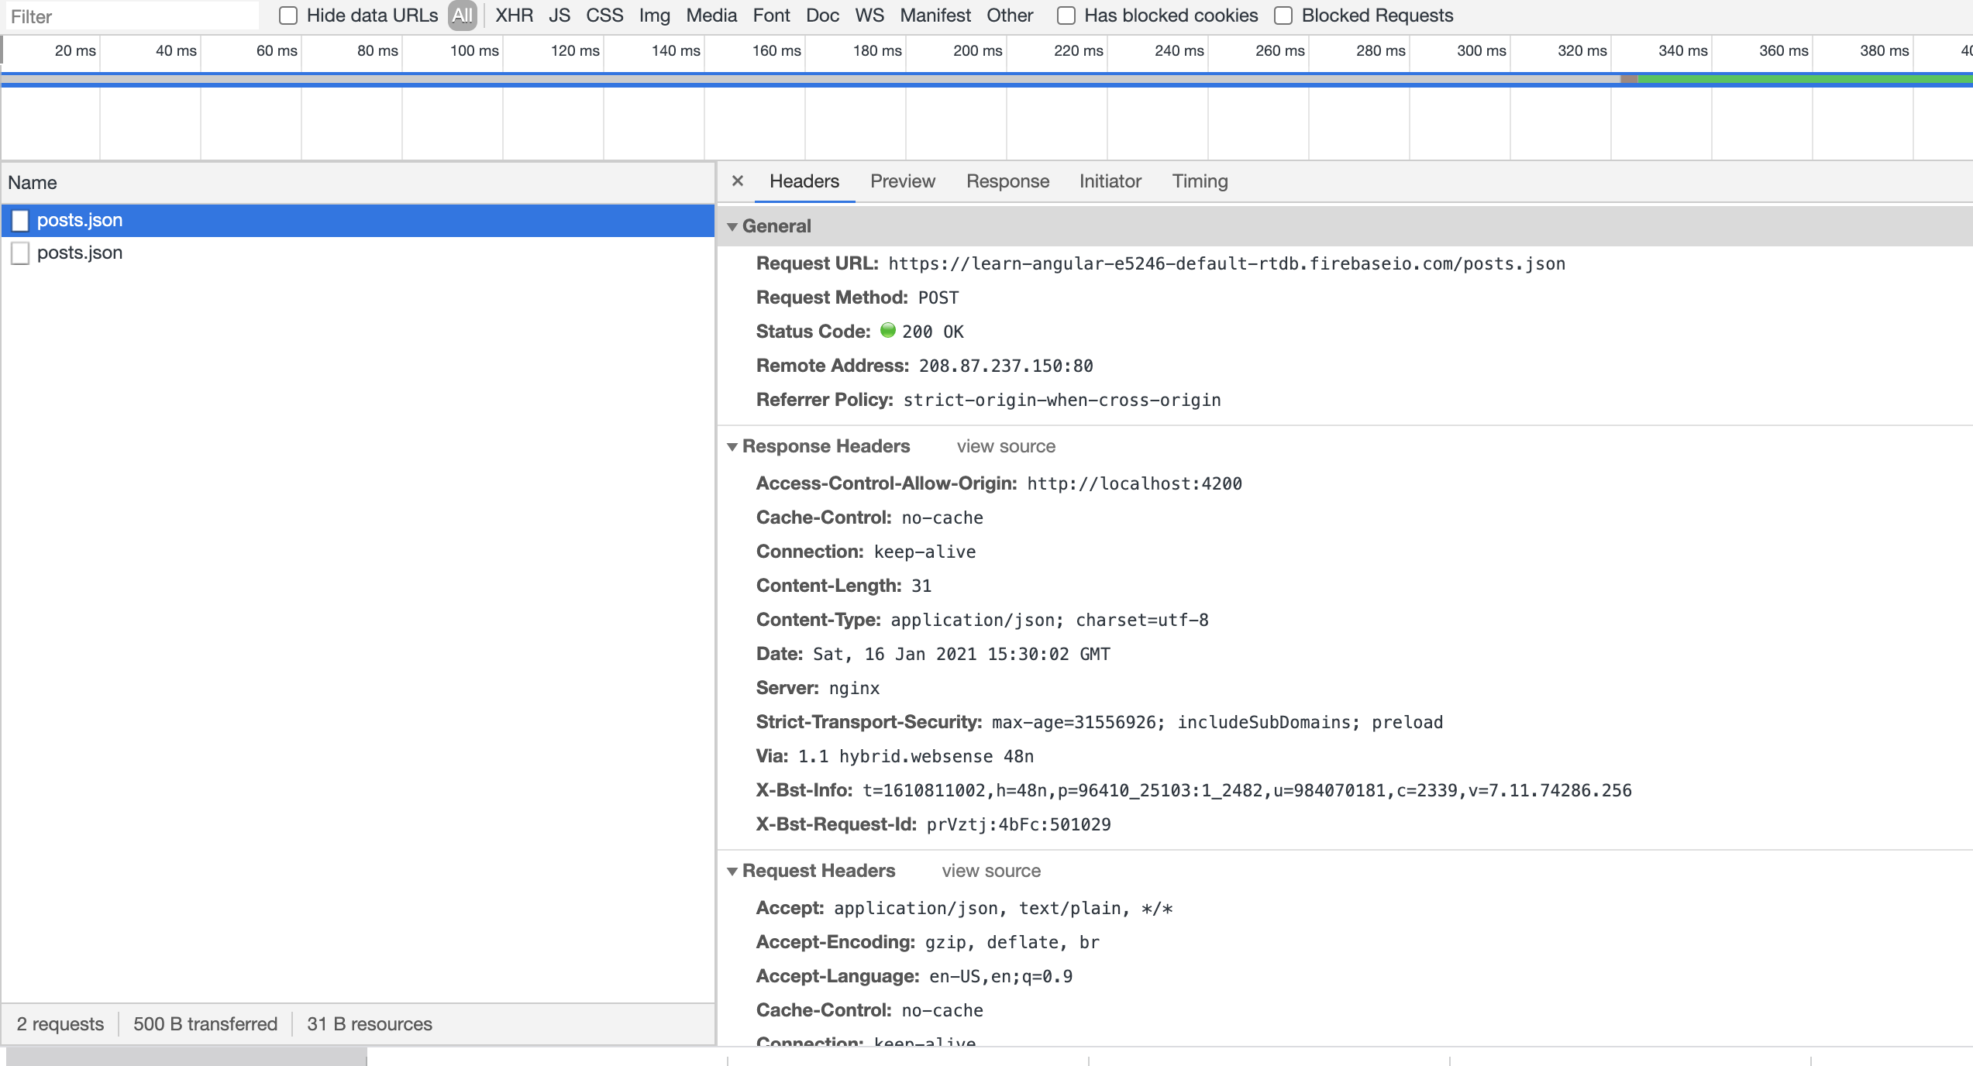
subscribe to post
Notes:
17

Slide 18
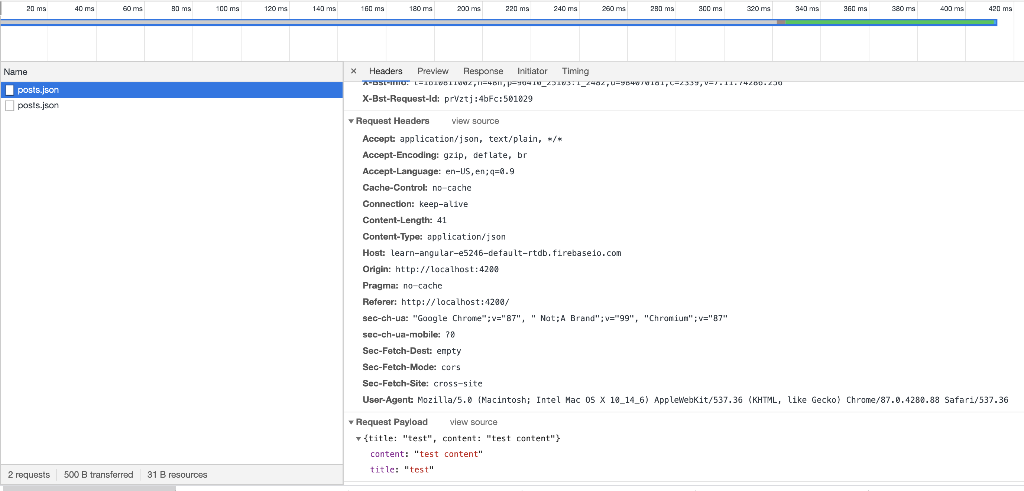
subscribe to post
Notes:
18

Slide 19
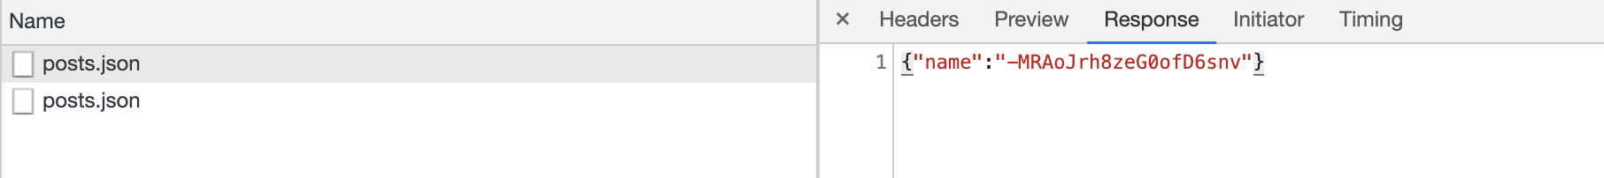
subscribe to post
Notes:
19

Slide 20
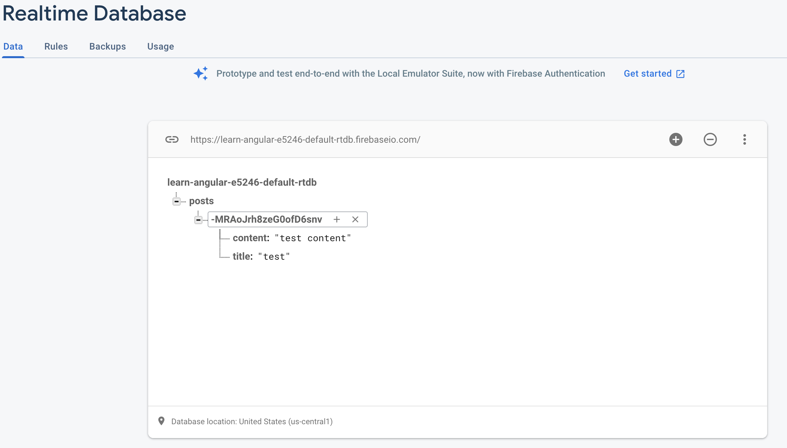
subscribe to post
Notes:
20

Slide 21
GET DATA
Notes:
21

Slide 22
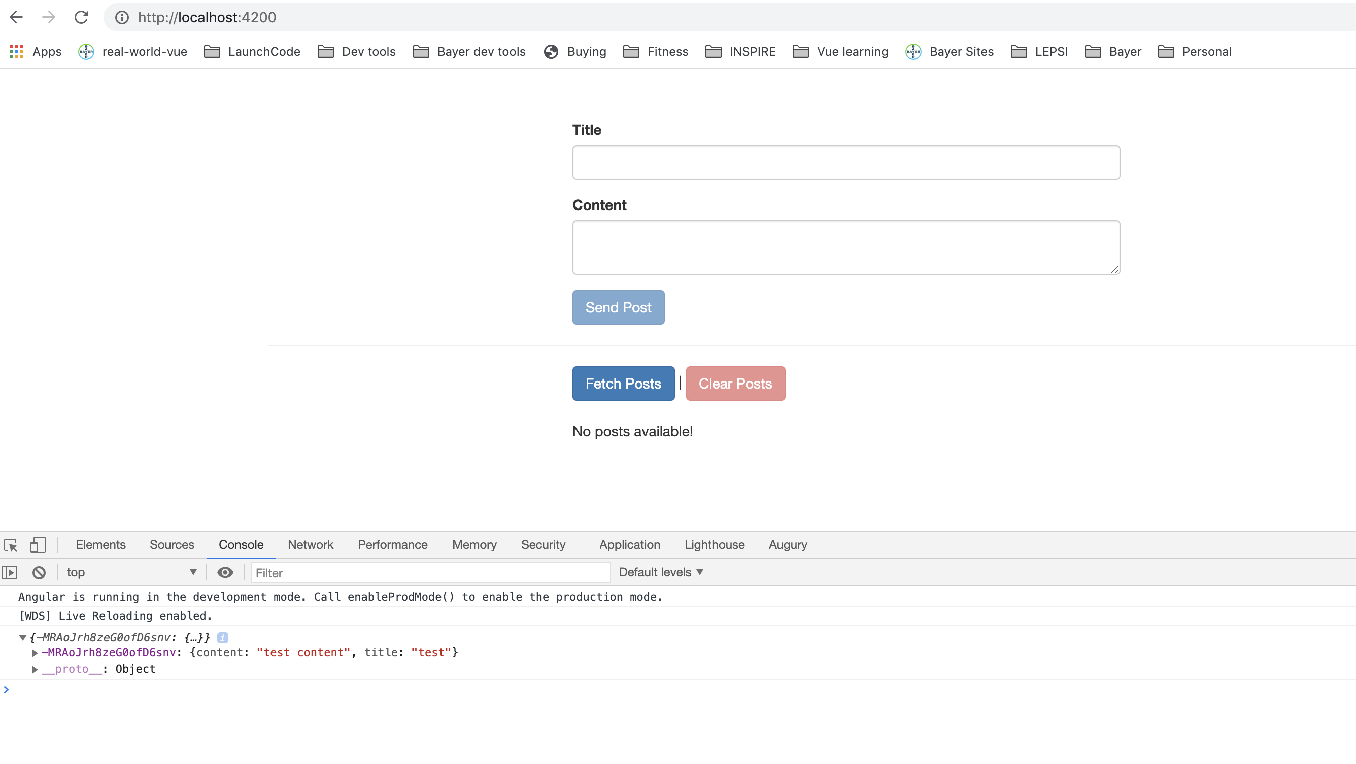
GET DATA
Notes:
22

Slide 23
GET DATA
https://developer.mozilla.org/en-US/docs/Web/JavaScript/Reference/Operators/Spread_syntax
Notes:
23

Slide 24
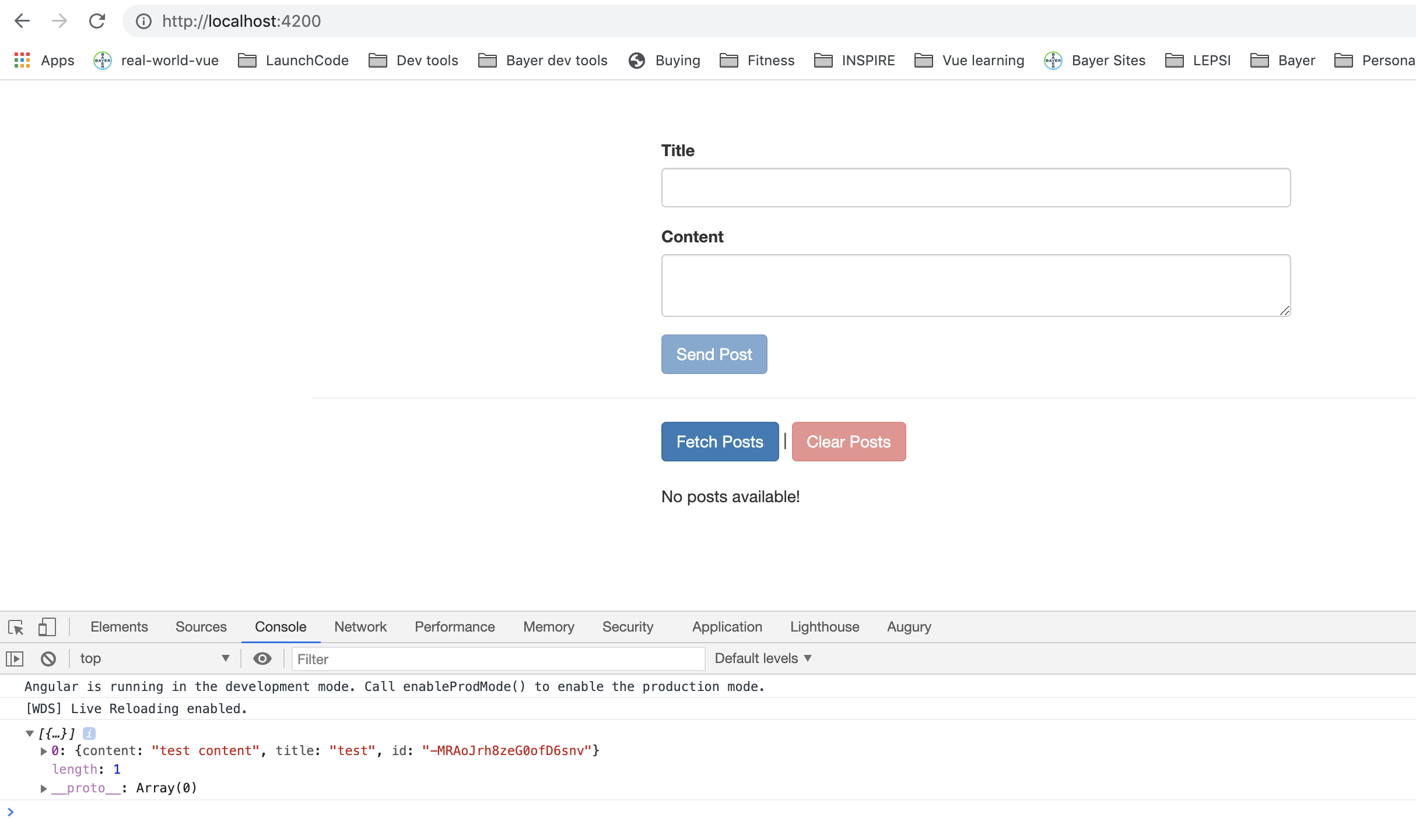
GET DATA
Notes:
24

Slide 25
GET DATA
Notes:
25

Slide 26
GET DATA
Notes:
26

Slide 27
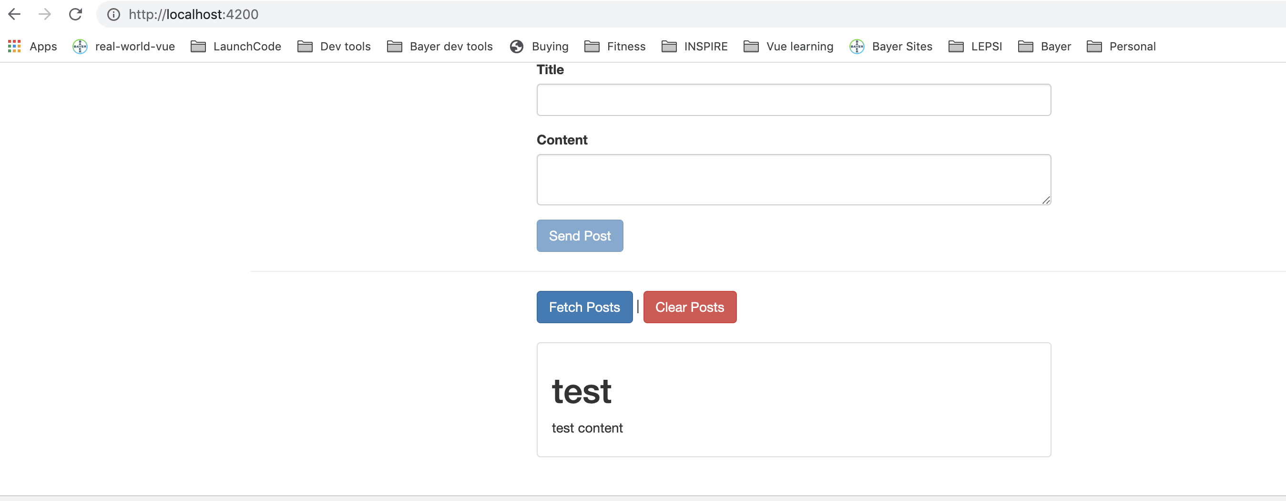
GET DATA
Notes:
27

Slide 28
Loading indicator
Notes:
28

Slide 29
Loading indicator
Notes:
29

Slide 30
USING a service for HTTp requests
Notes:
Outsourse code to services from components.
30

Slide 31
USING a service for HTTp requests
Notes:
Outsourse code to services from components.
31

Slide 32
USING a service for HTTp requests
Notes:
Outsourse code to services from components.
32

Slide 33
SERVICES AND COMPONENTS working together
Notes:
Outsourse code to services from components.
33

Slide 34
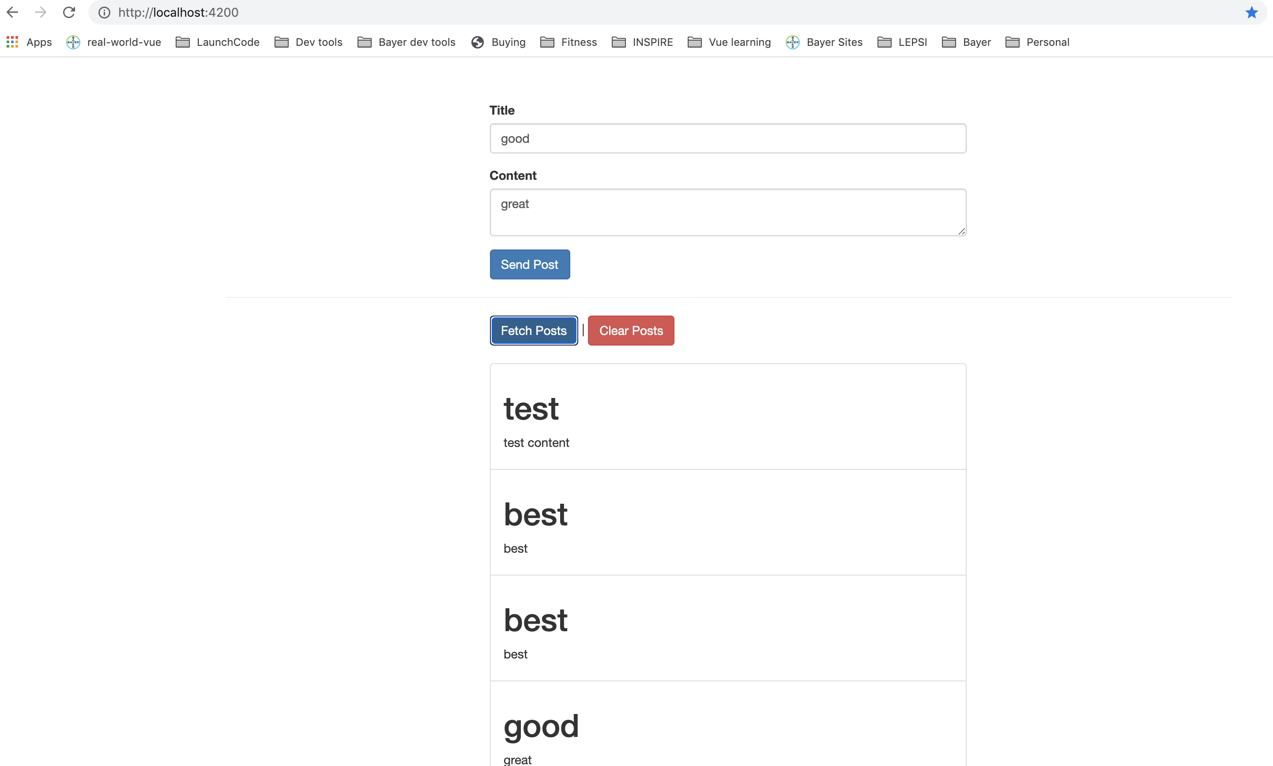
SERVICES AND COMPONENTS working together
Notes:
Outsourse code to services from components.
34

Slide 35
SERVICES AND COMPONENTS working together
Notes:
Outsourse code to services from components.
35

Slide 36
SENDING DELETE REQUEST
Notes:
Outsourse code to services from components.
36

Slide 37
SENDING DELETE REQUEST
Notes:
Outsourse code to services from components.
37

Slide 38
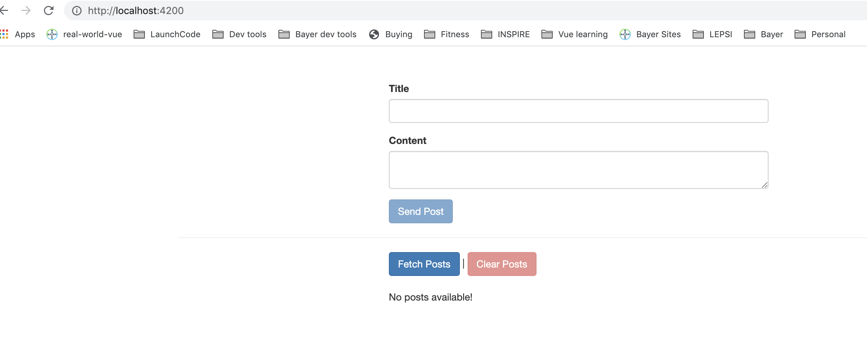
SENDING DELETE REQUEST
Notes:
Outsourse code to services from components.
38

Slide 39
HANDLING ERRORS
{
"rules": {
".read": "now < 1613282400000", // 2021-2-14
".write": "now < 1613282400000", // 2021-2-14
}
}
Notes:
Outsourse code to services from components.
39

Slide 40
HANDLING ERRORS
{
"rules": {
".read": ”false", // 2021-2-14
".write": "now < 1613282400000", // 2021-2-14
}
}
Notes:
Outsourse code to services from components.
40

Slide 41
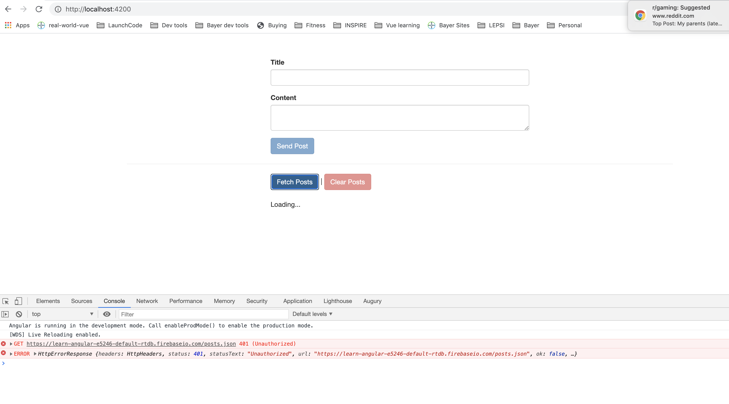
HANDLING ERRORS
Notes:
Outsourse code to services from components.
41

Slide 42
HANDLING ERRORS
Notes:
Outsourse code to services from components.
42

Slide 43
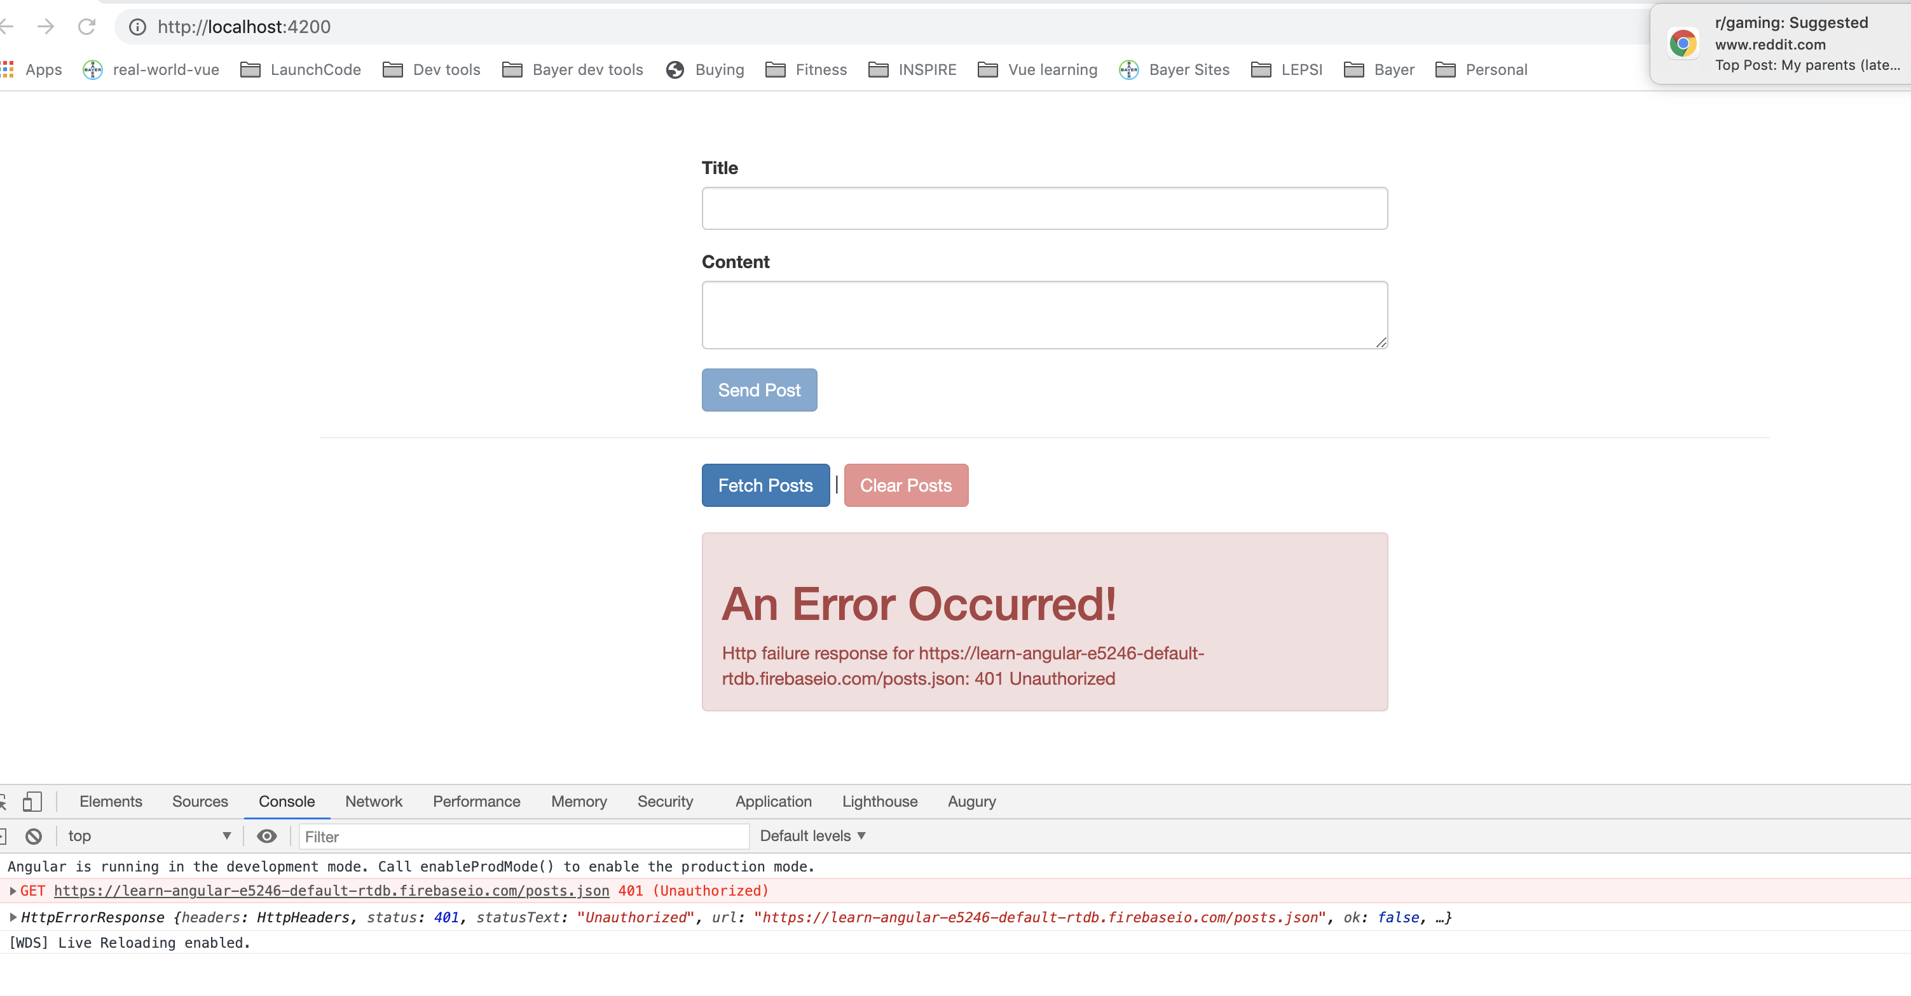
HANDLING ERRORS
Notes:
Outsourse code to services from components.
43

Slide 44
USING SUBJECTS FOR HANDLING ERRORS
Notes:
Outsourse code to services from components.
44

Slide 45
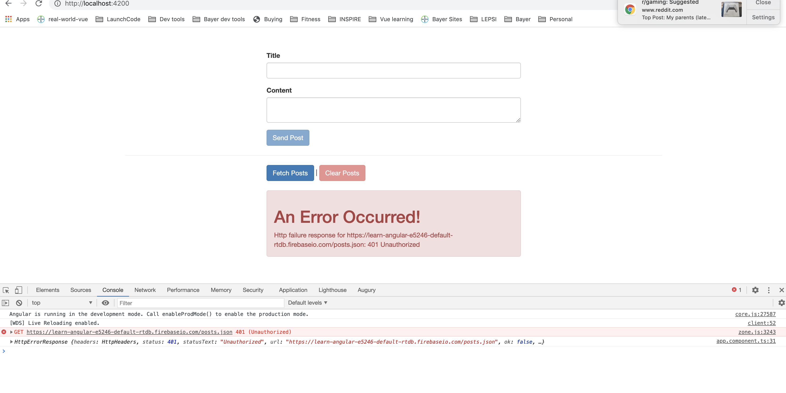
USING SUBJECTS FOR HANDLING ERRORS
Notes:
Outsourse code to services from components.
45

Slide 46
USING CATCHERROR
Notes:
Outsourse code to services from components.
46

Slide 47
HANDLING ERRORS
{
"rules": {
".read": "now < 1613282400000", // 2021-2-14
".write": "now < 1613282400000", // 2021-2-14
}
}
Notes:
Outsourse code to services from components.
47

Slide 48
ERROR HANDLING AND UX
Notes:
Outsourse code to services from components.
48

Slide 49
ERROR HANDLING AND UX
Notes:
Outsourse code to services from components.
49

Slide 50
ERROR HANDLING AND UX
Notes:
Outsourse code to services from components.
50

Slide 51
HANDLING ERRORS
{
"rules": {
".read": ”false", // 2021-2-14
".write": "now < 1613282400000", // 2021-2-14
}
}
Notes:
Outsourse code to services from components.
51

Slide 52
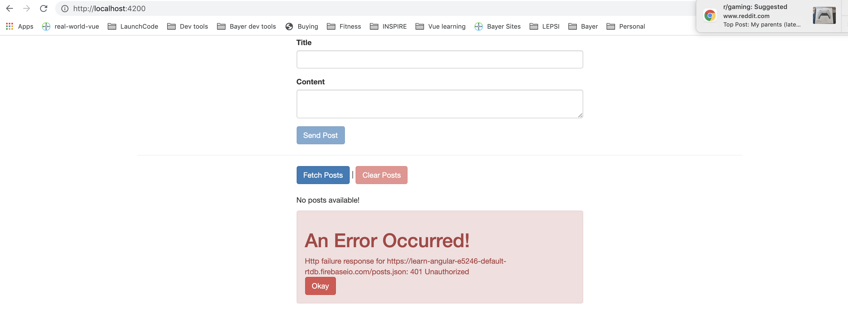
ERROR HANDLING AND UX
Notes:
Outsourse code to services from components.
52

Slide 53
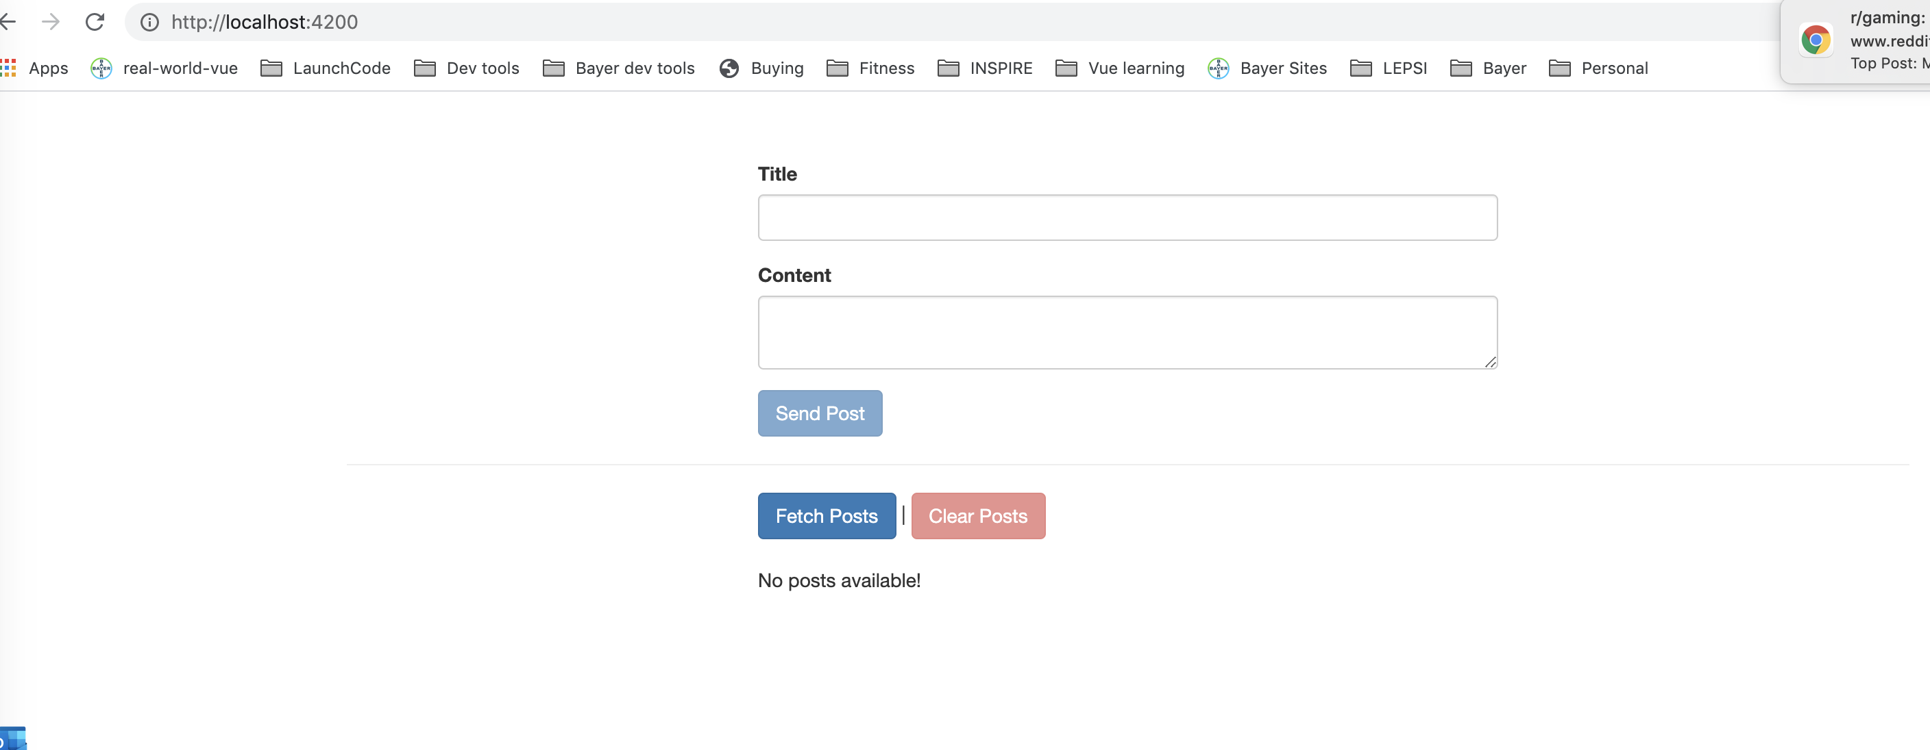
ERROR HANDLING AND UX
Notes:
Outsourse code to services from components.
53

Slide 54
HANDLING ERRORS
{
"rules": {
".read": "now < 1613282400000", // 2021-2-14
".write": "now < 1613282400000", // 2021-2-14
}
}
Notes:
Outsourse code to services from components.
54

Slide 55
SETTING HEADERS
Notes:
Might need to set headers, auth type etc. Any http request has extra last argument called headers
55

Slide 56
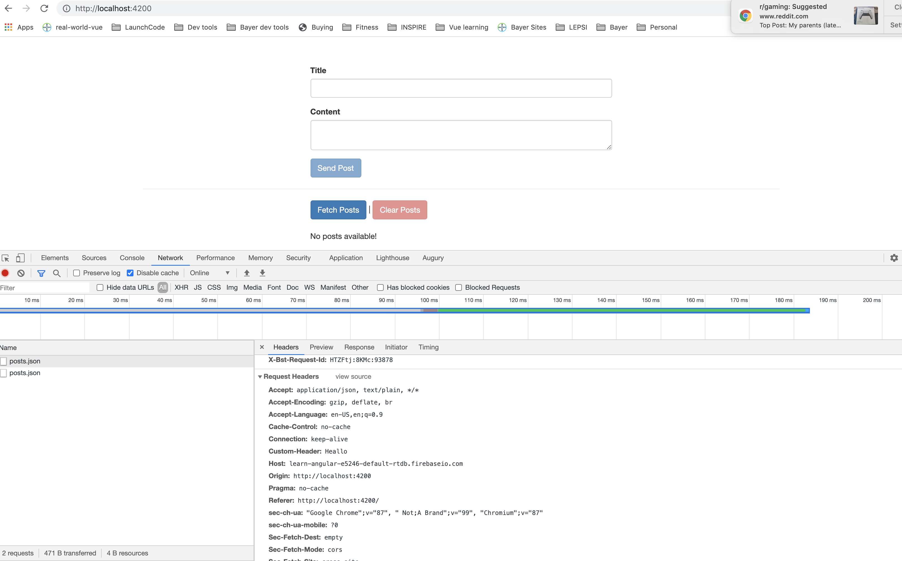
SETTING HEADERS
Notes:
Might need to set headers, auth type etc. Any http request has extra last argument called headers
56

Slide 57
ADDING QUERY PARAMS
Notes:
Might need to set headers, auth type etc. Any http request has extra last argument called headers
57

Slide 58
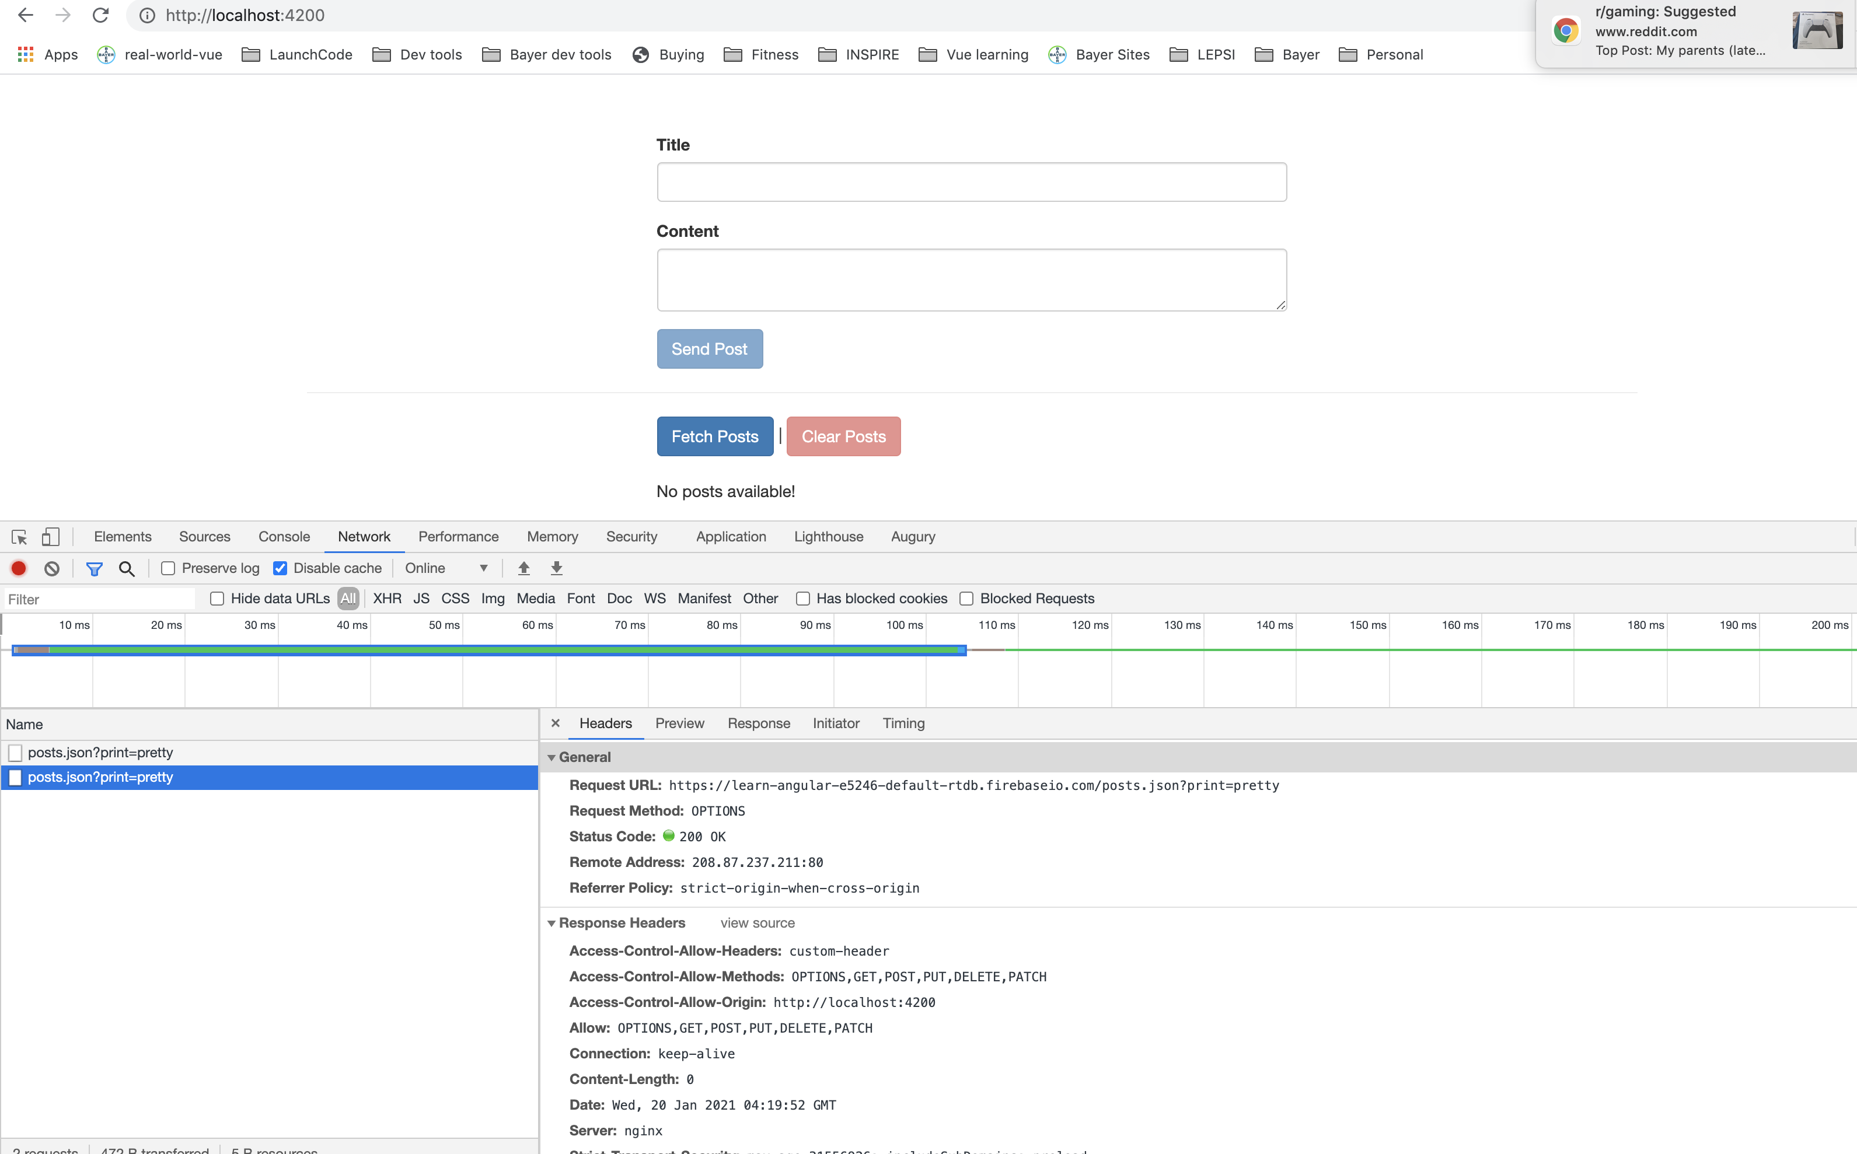
ADDING QUERY PARAMS
Notes:
Might need to set headers, auth type etc. Any http request has extra last argument called headers
58

Slide 59
ADDING QUERY PARAMS
Notes:
Might need to set headers, auth type etc. Any http request has extra last argument called headers
59

Slide 60
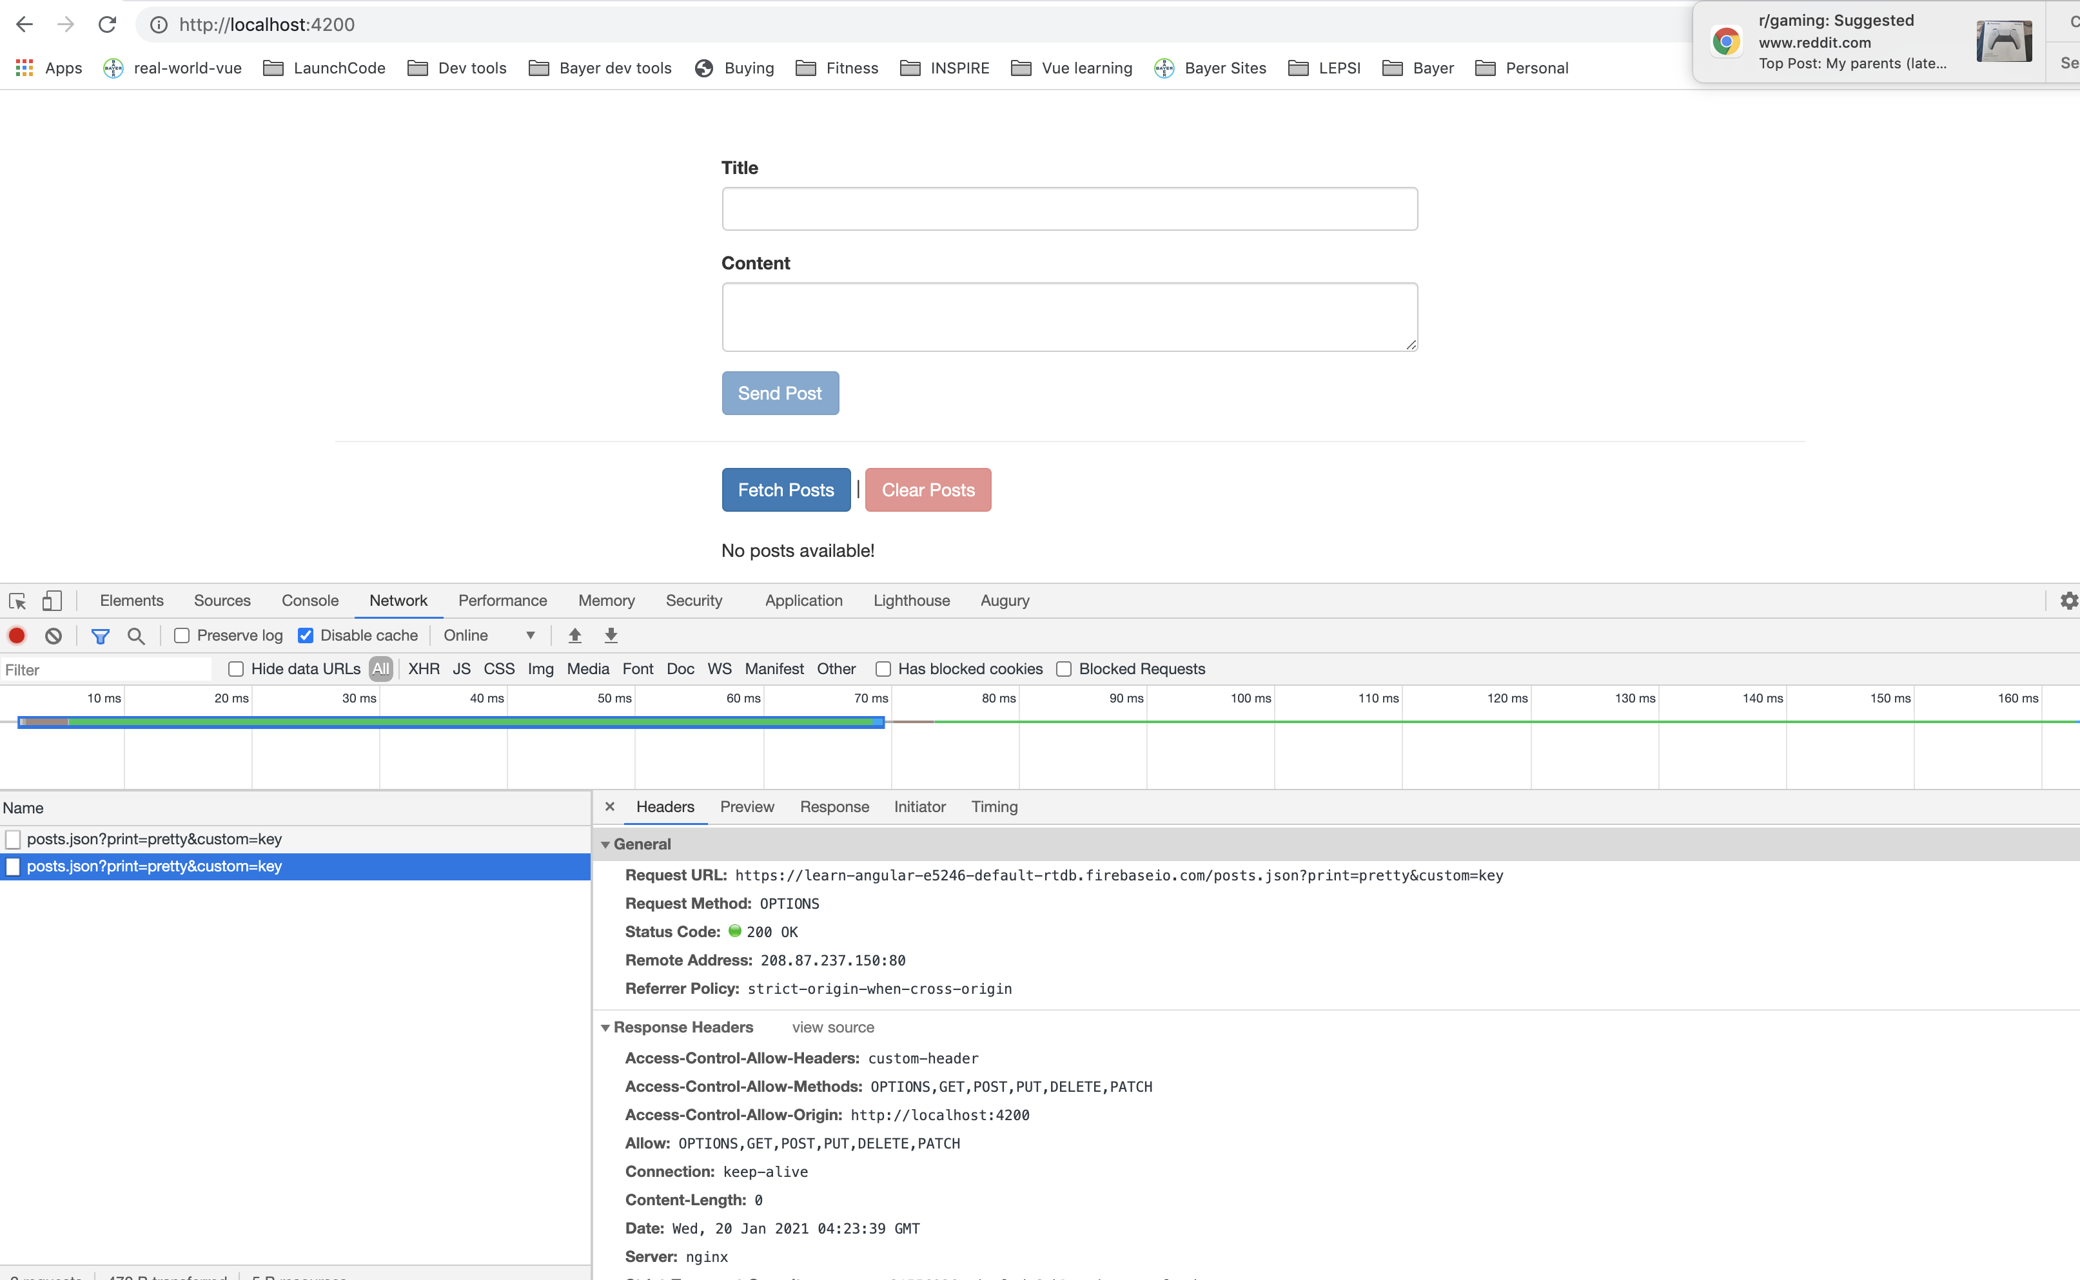
ADDING QUERY PARAMS
Notes:
Might need to set headers, auth type etc. Any http request has extra last argument called headers
60

Slide 61
OBSERVING DIFFERENT TYPES OF RESPONSES
Notes:
Entire response object. Can change how angular parses the response.
61

Slide 62
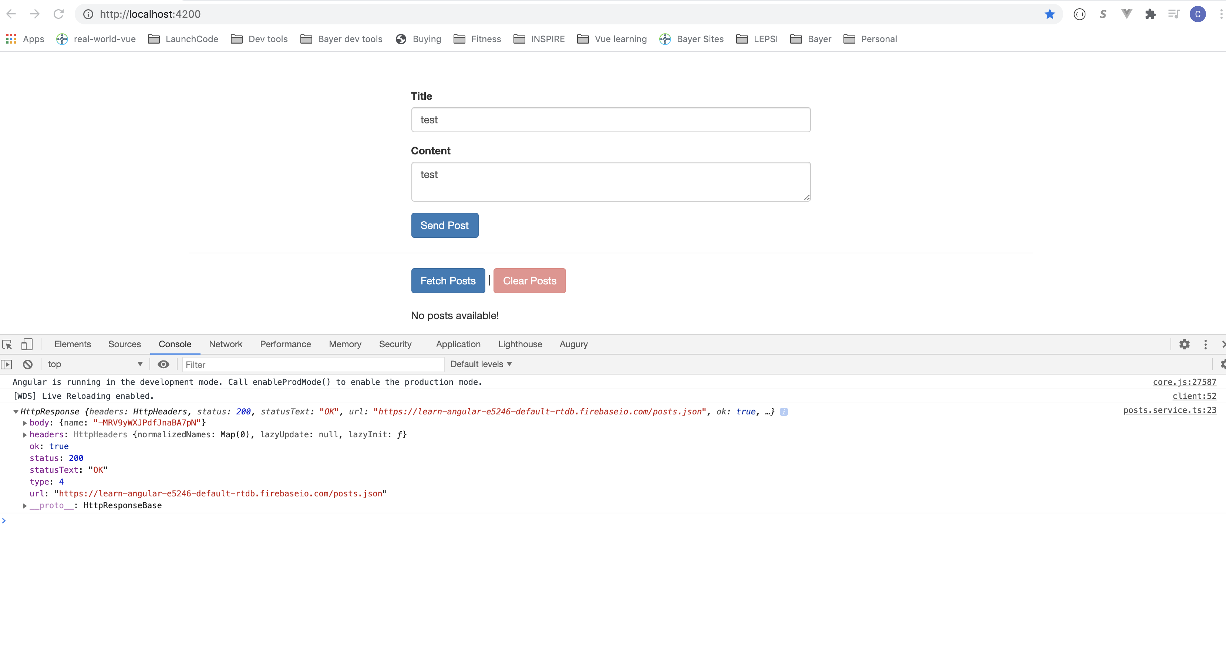
OBSERVING DIFFERENT TYPES OF RESPONSES
Notes:
Entire response object. Can change how angular parses the response.
62

Slide 63
OBSERVING DIFFERENT TYPES OF RESPONSES
Notes:
Do something with response without altering it. Type 0 – empty object. Types of events
63

Slide 64
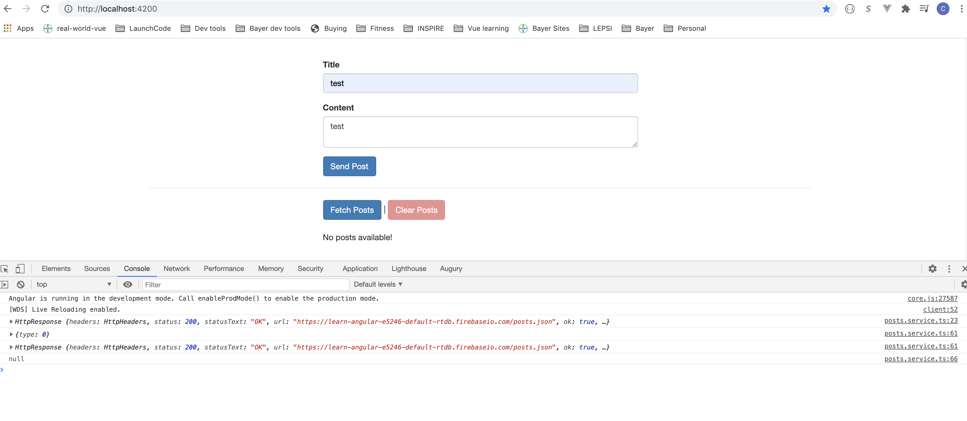
OBSERVING DIFFERENT TYPES OF RESPONSES
Notes:
Do something with response without altering it. Type 0 – empty object. Types of events
64

Slide 65
Changing the RESPONSE body type
Notes:
You can tell Angular to use responseType of text instead of converting it to JSON. If we change the fetchPosts response type to text, typescript will have a compile error. You can also set responseType to json.
65

Slide 66
INTERCEPTORS
Notes:
Sending http request. We are setting params for every request. What if we want to set custom headers to reach request. It will be cumbersome to add to each request. For example authentication. Intercept method is run right before request is made. Angular runs the interceptor intercept method for each request once added to app.module.
66

Slide 67
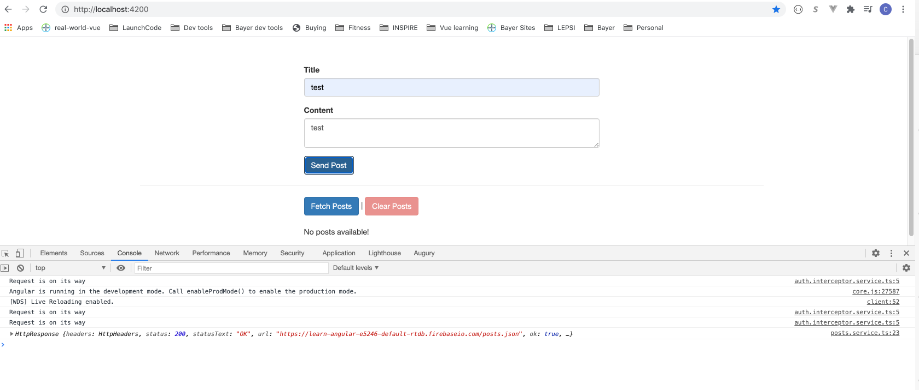
INTERCEPTORS
Notes:
Sending http request. We are setting params for every request. What if we want to set custom headers to reach request. It will be cumbersome to add to each request. For example authentication. Intercept method is run right before request is made. Angular runs the interceptor intercept method for each request once added to app.module.
67

Slide 68
MANIPULATING REQUEST OBJECTS
Notes:
Request object is immutable. Have to crearte a new one if you want to modify.
68

Slide 69
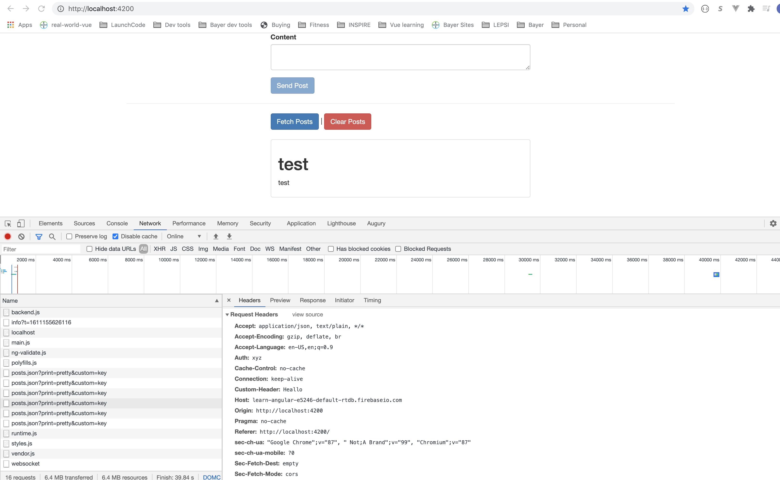
MANIPULATING REQUEST OBJECTS
Notes:
Request object is immutable. Have to crearte a new one if you want to modify.
69

Slide 70
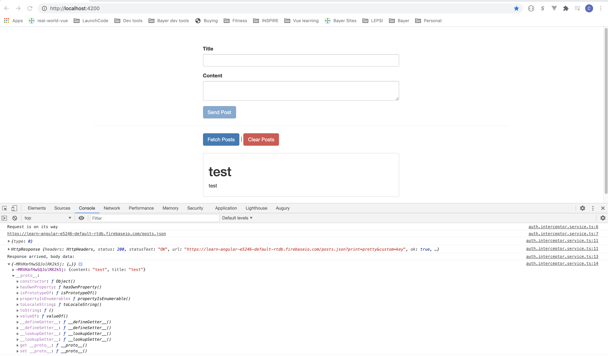
RESPONSE INTERCEPTORS
Notes:
Could intercept response. You can add map to make changes to the response.
70

Slide 71
MULTIPLE INTERCEPTORS
Notes:
Order in which added to app module is the order in which they are executed.
71

Slide 72
MULTIPLE INTERCEPTORS
Notes:
Could intercept response. You can add map to make changes to the response.
72

Slide 73
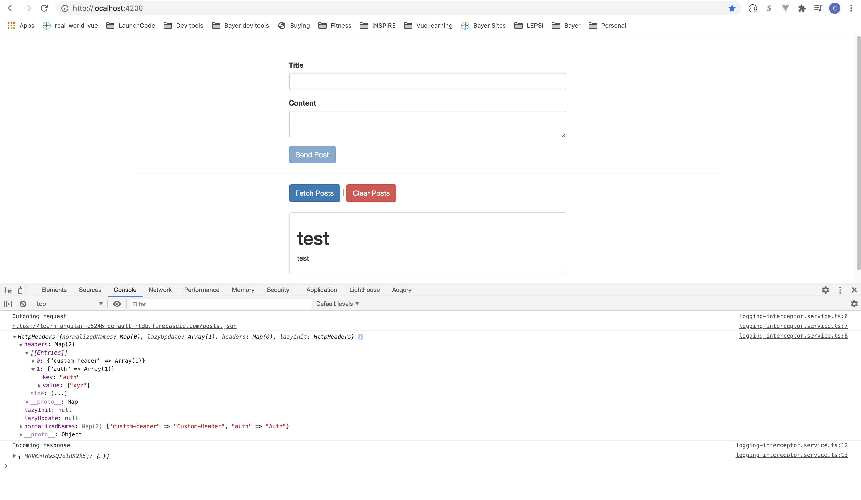
MULTIPLE INTERCEPTORS
Notes:
Could intercept response. You can add map to make changes to the response.
73

Slide 74
SUMMARY
http has a lot of features and options!
Notes:
74

Slide 75
Questions?

Slide 76
Studio
Course Project - Http

